Slide 1
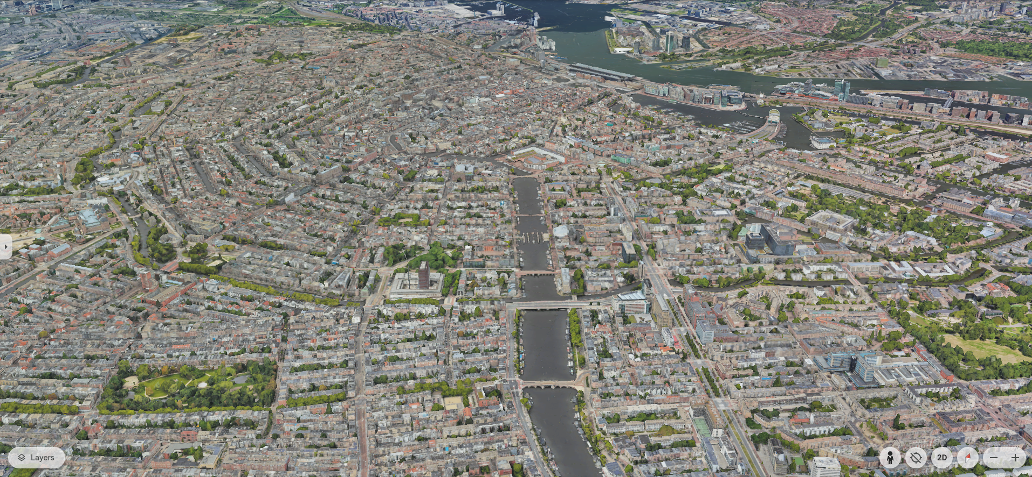
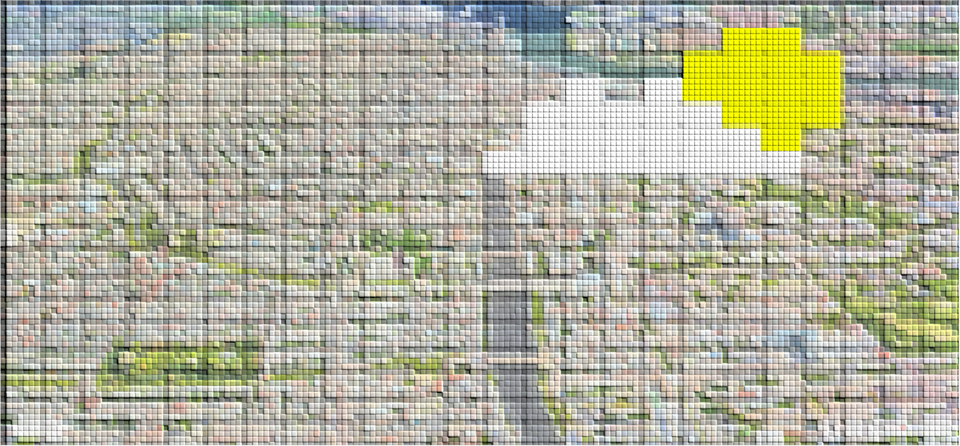
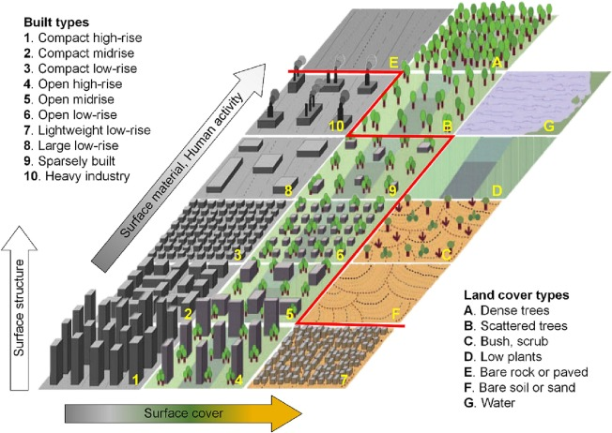
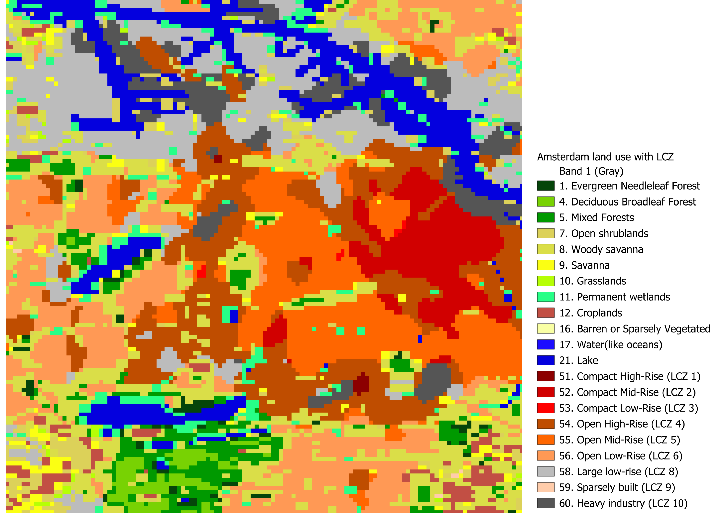
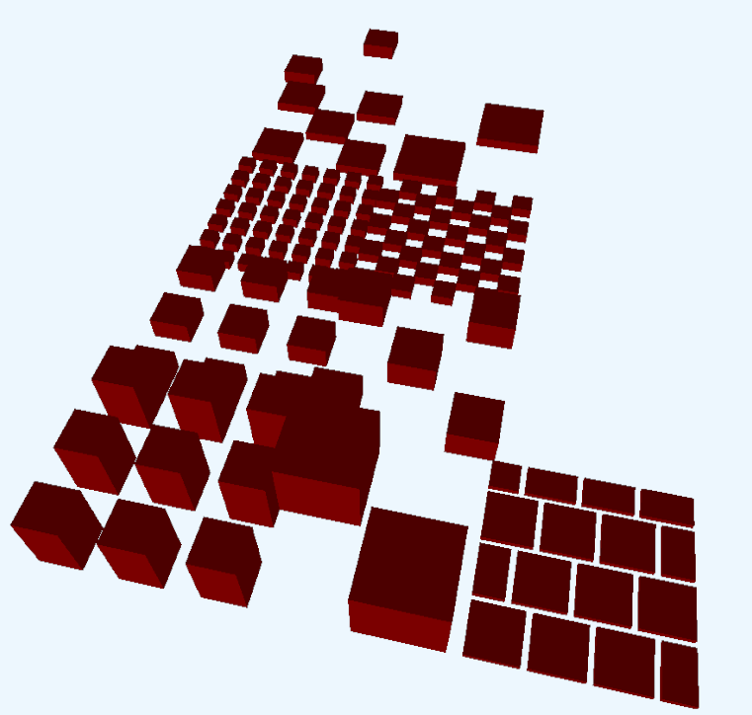
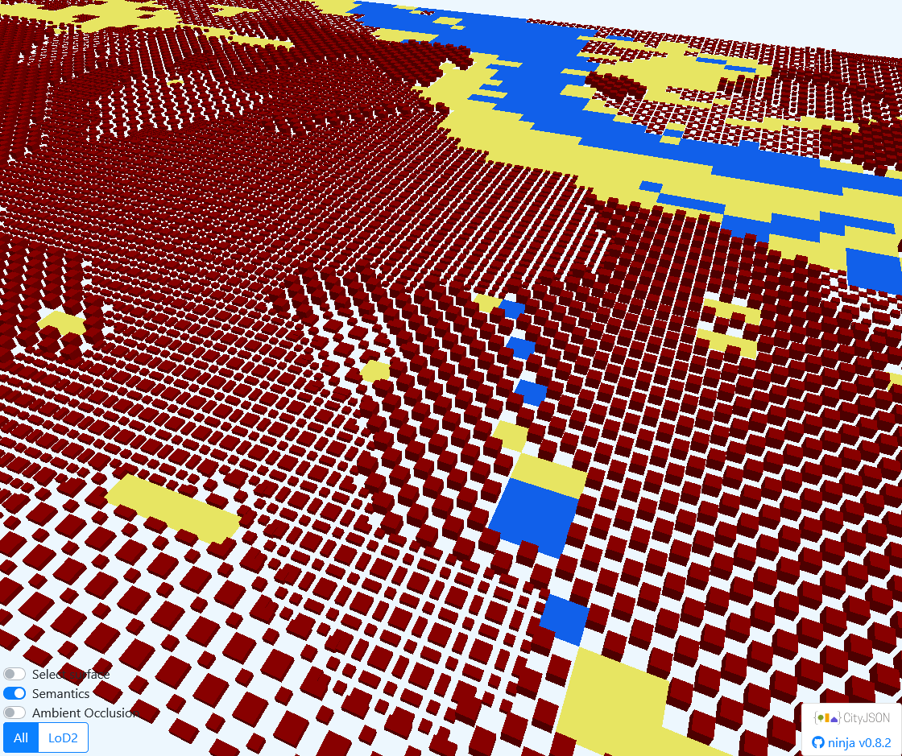
The city as we see it
City weather is simulated by grid-box models with limited detail
Local climate zones describe city traits at block level
I don’t really feel those flat maps, so I tried to render them in 3D instead

Slide 2
Source of rasterized image (table overlaid on image). Pasted as image in other slide, then apply picture effect

